Slide 1
Lecture 17 Embedded Systems Research
CE346 – Microcontroller System Design
Branden Ghena – Fall 2024
Some slides borrowed from: Josiah Hester (Northwestern), Prabal Dutta (UC Berkeley)

Slide 2
Administrivia
This is the last lecture!! 😭
No class after Thanksgiving
I’ll hold office hours in the lecture room
Project Demos – Tuesday of Exam Week
Tuesday 12/10, Mudd 3514, 11:00-5:00 pm
Groups will do half that time (either 11-2 or 2-5)
I’ll request preferences and release a schedule next week

Slide 3
Today’s Goals
Explore sensing systems research
What does it mean to do “research”
Explore a research project in that context (Powerblade)
Discuss some example Sensing Research projects
Most shallowly
Signpost project deeply

Slide 4
Outline
What does research look like:
Research Overview
Example: Powerblade
Sensing Systems Research
Various Projects
Signpost

Slide 5
What is research anyways?
I think of research as just “figuring stuff out”
This is part of why research feels so vague: there are many ways to figure things out, depending on the question
Read papers
Run experiments
Send out surveys
Build something

Slide 6
Academic research
We all do research all the time in our daily lives
Academic research is mostly about the question you’re figuring out
Is the question important in some way?
Is the question something that’s not trivial to answer?
Does the answer provide value?
Finding the “right” questions is hard

Slide 7
Academic research in engineering
Often intertwines the act of “figuring out” with development
Need to build something to try out and that can answer the question
Hard part is remembering that the question is more important than the engineering
Building something that only partially works is fine if it answers the question
We call this a research prototype
Unfortunately, something working in a research paper is definitely not the same as a working product

Slide 8
Getting a PhD
PhD students “do research”
Getting a PhD requires a thesis (a good question) and a dissertation (describing and proving the answer)
PhDs in engineering in US
5-6 years average
Are paid for! (tuition plus $30k-40k)
Are not a good monetary decision in CS
There are other reasons for them, just not for money

Slide 9
Getting involved in research
Research with faculty
Often take a 300-level course with a faculty and do well
Then talk to them about joining their lab
NSF Research Experience for Undergrads
Summer programs held at universities throughout the US
You apply for these, like internships
Any research counts! Even if it’s not in exactly your field
You’ll find more similarities than differences
It all looks similarly good on applications

Slide 10
Research outputs
Papers (Journal, Conference, Workshops, etc.)
Provide a mechanism for others to find your work
Peer-reviewed papers are reviewed by other professors in the field to ensure that the seem valid
Good papers do the following
Explain what the problem is
Explain why the problem is important
Explain how other research relates to this
Explain an answer to the problem
Prove that the answer to the problem is real
Explain the limitations of the answer

Slide 11
Outline
What does research look like:
Research Overview
Example: Powerblade
Sensing Systems Research
Various Projects
Signpost

Slide 12
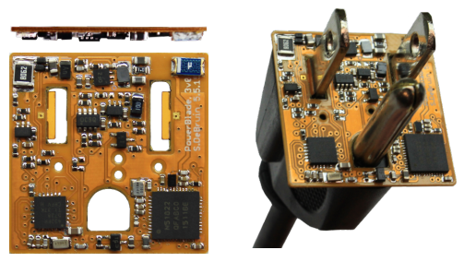
Powerblade (DeBruin, Ghena, Kuo, Dutta)
1” x 1” x 1/16” plug load power meter
Measures AC voltage and current and reports real-time power draw over Bluetooth Low Energy
Question: can a plug-load power meter be created in a 2D form factor to enable easy deployability while still being accurate?
https://brandenghena.com/projects/powerblade/debruin15powerblade.pdf

Slide 13
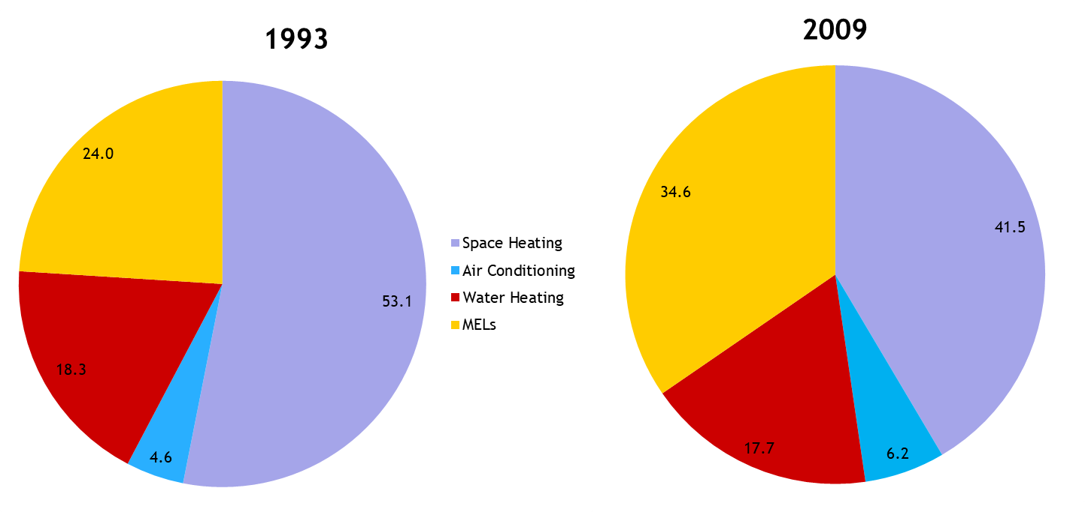
What is the problem and why is it important?
Miscellaneous electrical loads (MELs) occupy an increasingly large percentage of overall energy use

Slide 14
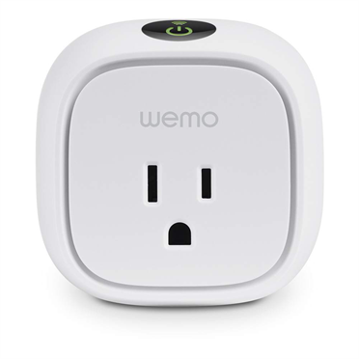
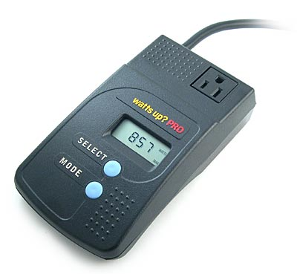
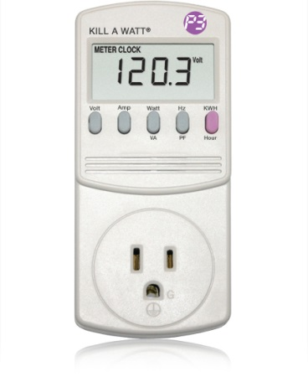
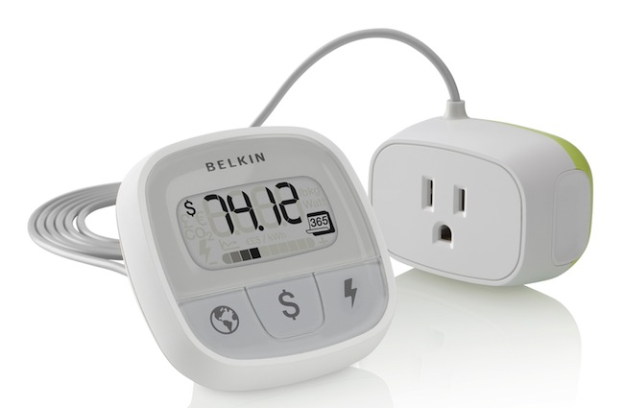
What is the problem and why is it important?
Existing power meters are too cumbersome for ubiquitous deployment
Goal: unobtrusively measure all plug-loads in a home over a long period of time with high fidelity and low cost
Needs to be real-world sustainable
Needs to not impede daily life

Slide 15
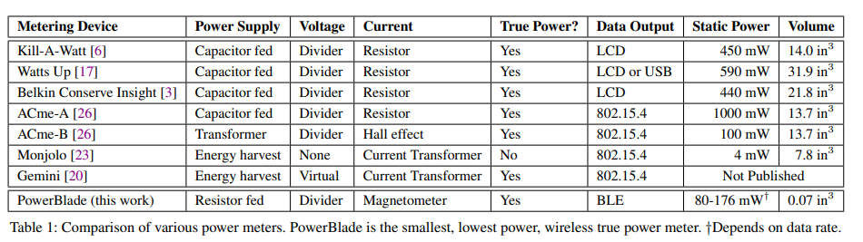
How does other work relate to this?
No other devices are as small as Powerblade
Many use more power themselves
Some do not have wireless communication or measure real power
Real Power?

Slide 16
What is an answer to the problem?
Must re-think design of power meters from basics
Five core steps that a power meter must handle
Convert AC mains voltage to usable DC voltage
Measure voltage
Measure current
Calculate power and energy
Communicate measurements
Revisit each and show that it can be changed

Slide 17
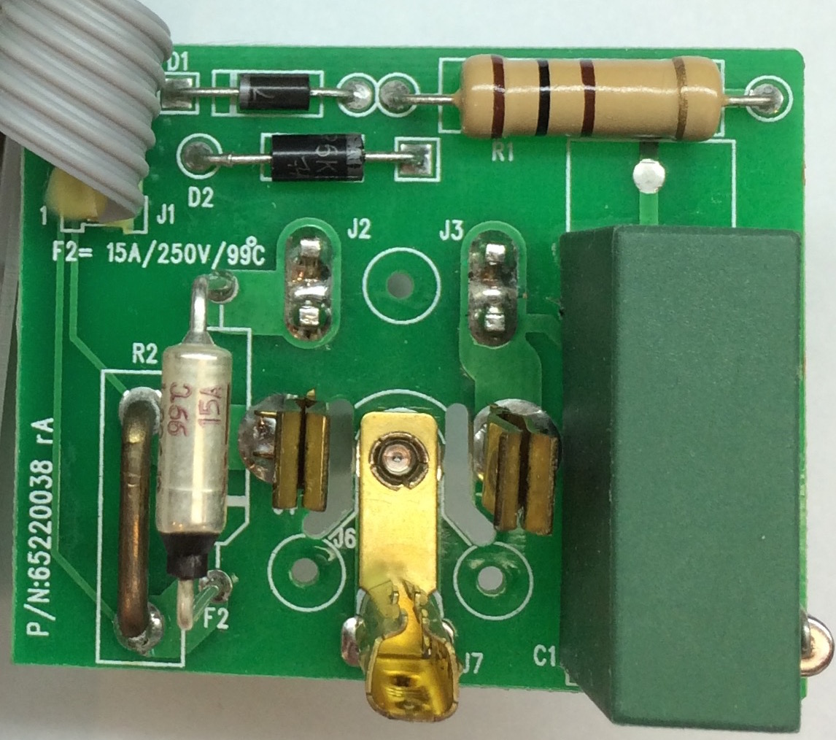
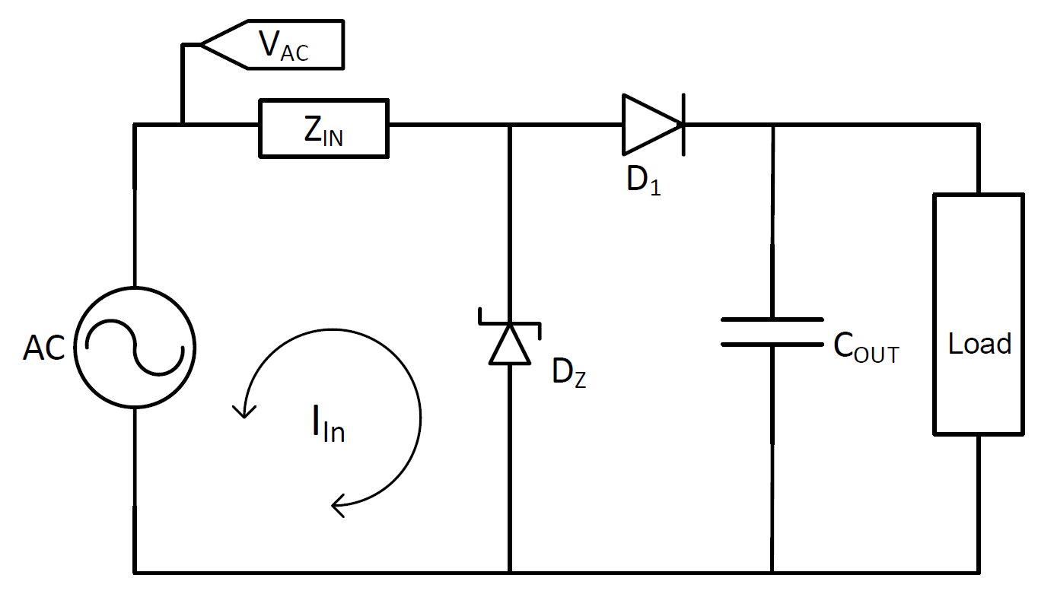
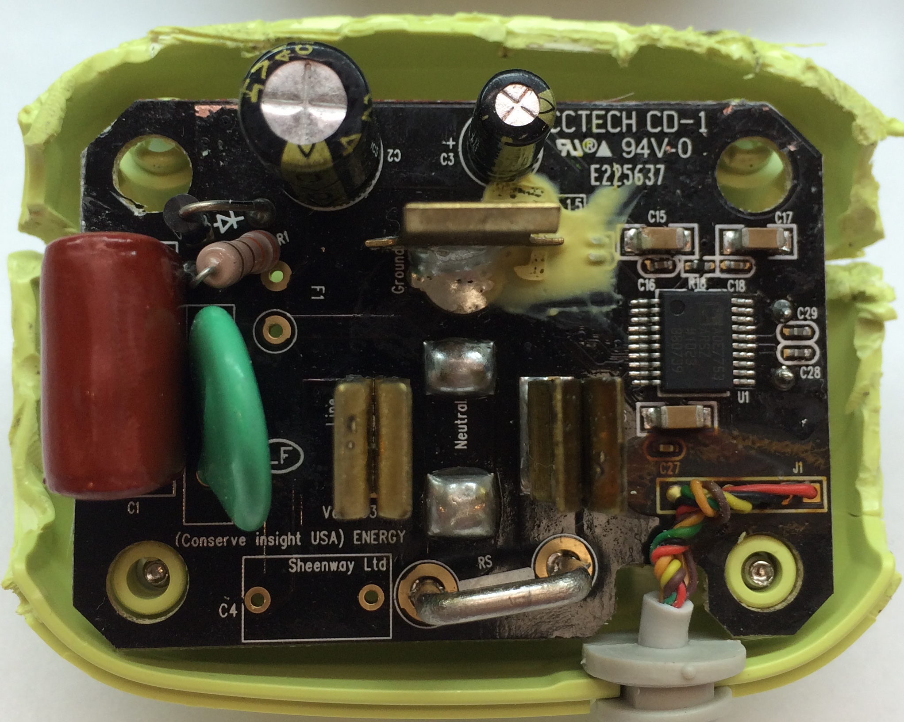
Answer - creating a usable DC voltage
Basic circuit below applies
But usually Z_{in} is a large capacitor to provide enough power for the device to run
We can instead use a small resistor if our average current is very low (< 800 μA)
Kill-A-Watt
Belkin Insight

Slide 18
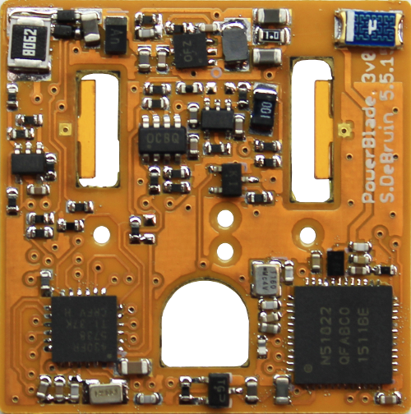
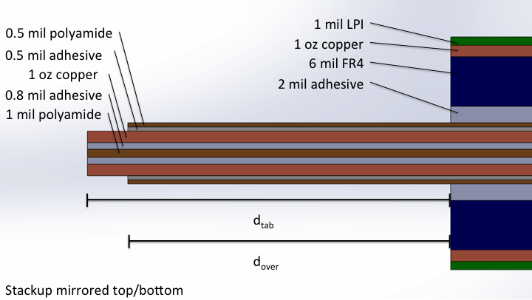
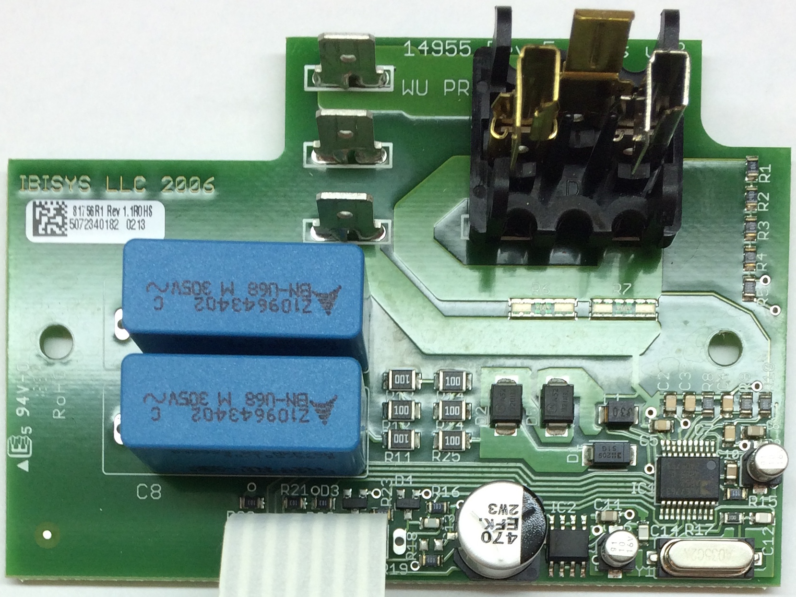
Answer - measuring voltage
Sockets take up a lot of physical room
Flexible tabs
Instead use flexible PCB tabs
(This was finicky and non-reusable in practice)

Slide 19
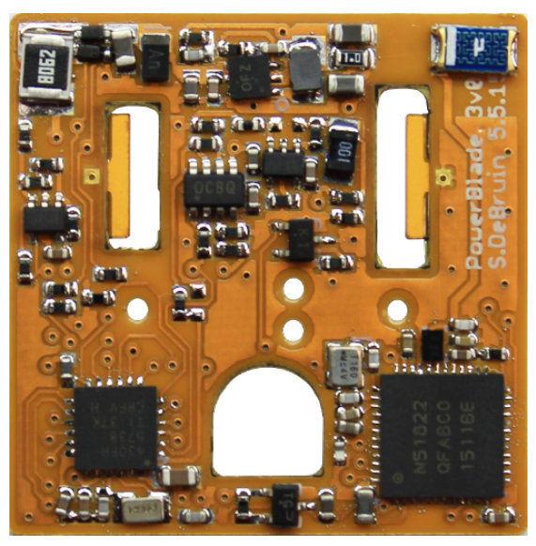
Answer - measure current
Horizontally wound coil translates magnetic field into a voltage
Creates a signal that is the derivative of current

Slide 20
Answer - calculate power and energy
Perform computation in a modern microcontroller
Keeps up with calculations that an IC usually does
MSP430FRxx - MSP430 with FRAM
Can perform work at a very low average power
Sampling, integration, computation, and output

Slide 21
Answer - communicate measurements
Transmitting average power over BLE presents results while keeping within energy budget
Update average measurements once per second
Send 5 packets per second for reliability

Slide 22
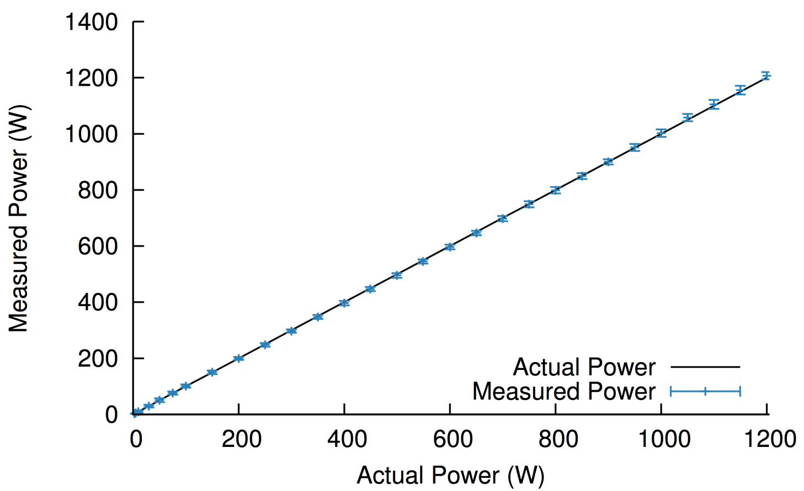
Prove that the answer to the problem is real
Device | Power Factor | Power | PowerBlade Error
150 W Bulb | 1.00 | 162.17 W | -0.99 W | 0.61%
Fridge | 1.00 | 108.22 W | -5.30 W | 4.90%
Drill (Max) | 0.99 | 253.21 W | 2.96 W | 1.26%
Toaster | 0.99 | 827.87 W | -22.11 W | 2.67%
Vacuum | 0.98 | 1246.96 W | 15.24 W | 1.22%
Microwave | 0.92 | 1729.73 W | 16.01 W | 0.93%
Hot Air Gun | 0.83 | 305.54 W | -1.93 W | 0.63%
TV (Normal) | 0.62 | 196.23 W | -9.03 W | 4.60%
TV (Static Image) | 0.61 | 129.51 W | -4.00 W | 3.09%
50 W CFL | 0.61 | 48.57 W | -9.51 W | 19.58%
Xbox One | 0.57 | 50.44 W | -0.83 W | 1.65%
MacBook | 0.51 | 52.68 W | -4.49 W | 8.52%
Blender | 0.49 | 106.63 W | 36.97 W | 34.67%
Router | 0.46 | 9.11 W | -0.62 W | 6.81%
Drill (Low) | 0.30 | 51.10 W | 20.40 W | 39.92%
From 2 W to 1200 W, average error is 1.13%

Slide 23
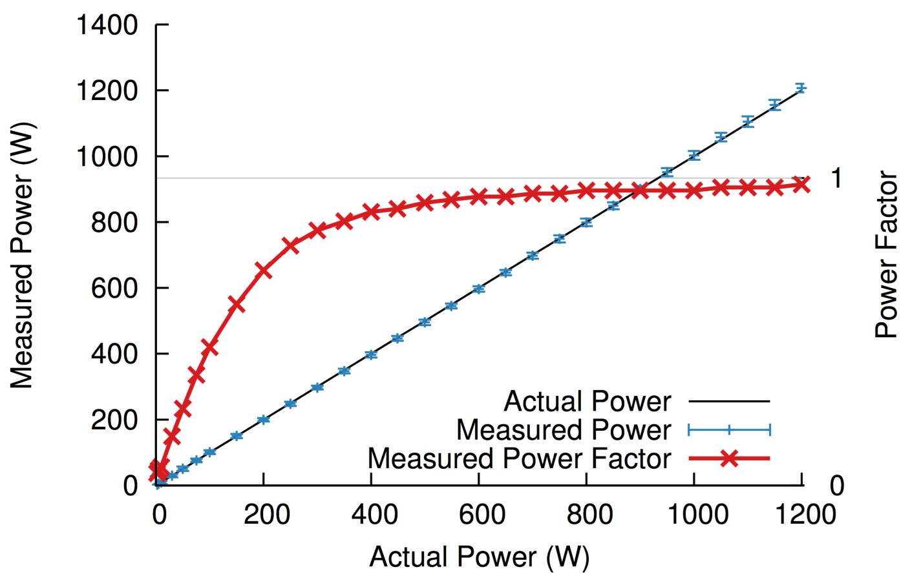
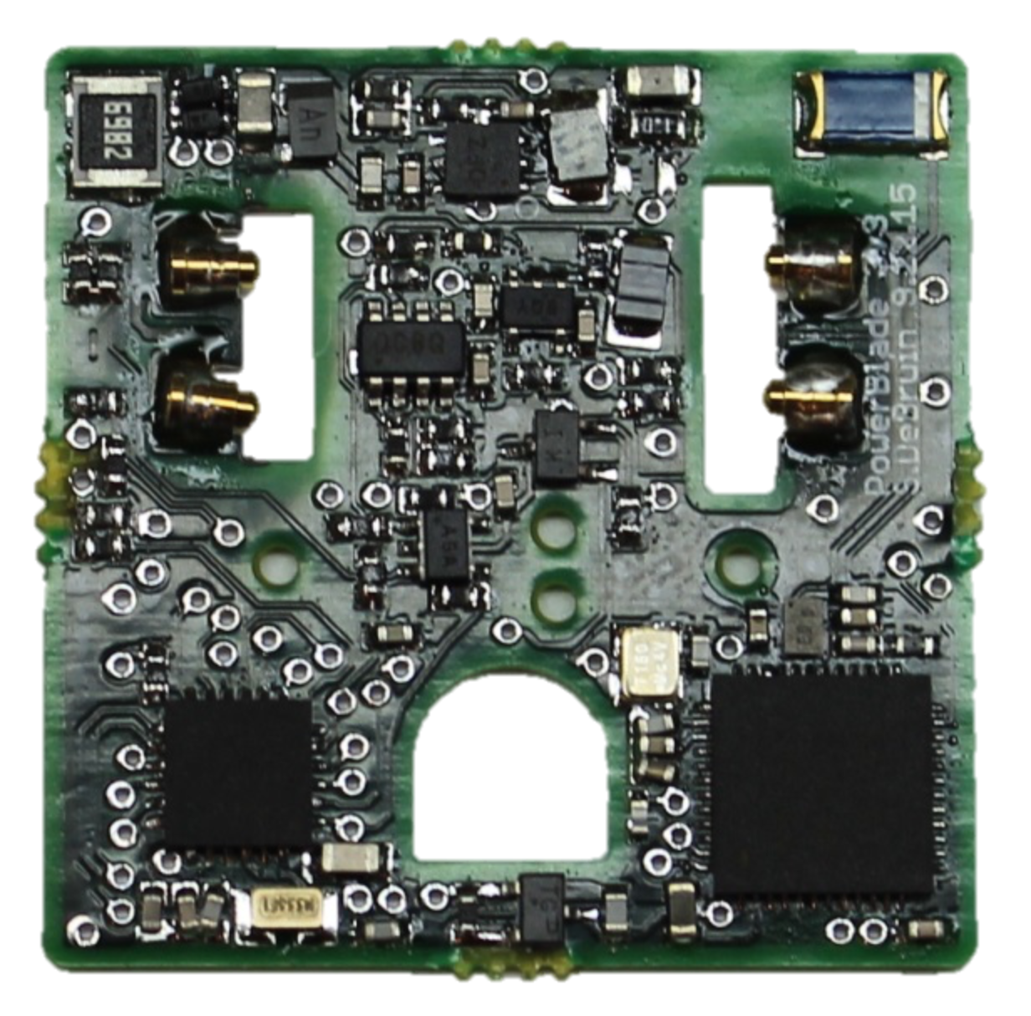
Explain the limitations
Power factor measurements are very power at low wattages
Although the wattage itself remains accurate
Also change to pogo pins for better, repeatable contact

Slide 24
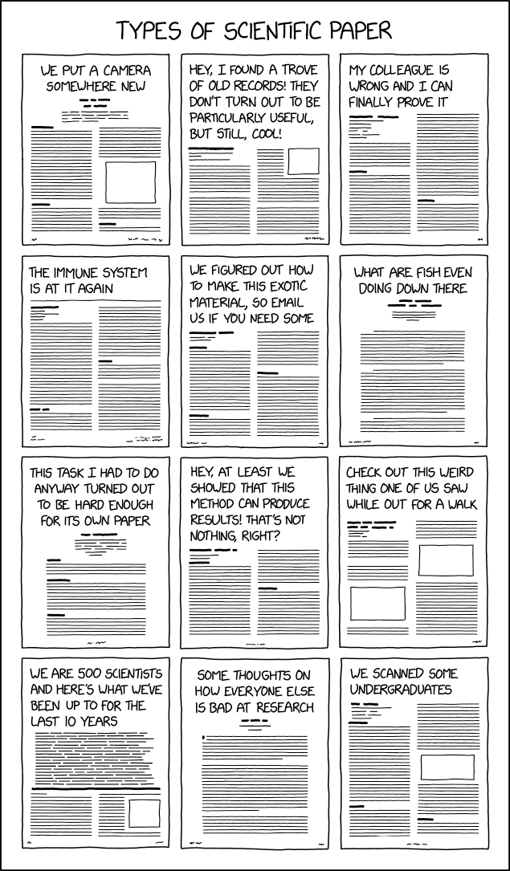
Break + xkcd
https://xkcd.com/2456/

Slide 25
Outline
What does research look like:
Research Overview
Example: Powerblade
Sensing Systems Research
Various Projects
Signpost

Slide 26
Conferences for sensing systems research
SenSys
Conference on Embedded Networked Sensor Systems
IPSN
Conference on Information Processing in Sensor Networks
EWSN
Conference on Embedded Wireless Systems and Networks
MobiCom
Conference on Mobile Computing and Networking
UbiComp
Conference on Pervasive and Ubiquitous Computing
Various other systems or HCI venues
Occasionally Electrical or Civil Engineering venues too

Slide 27
Sensing systems research
Combination of engineering and exploration
Generally divides into two different focuses
Often projects will mix some of each domain
Platforms
How to improve the capabilities of sensing systems
Examples: lower power, better wireless, new sensors
Applications
How to use sensing systems to meet some desired goal
Examples: track human interactions, measure household energy use

Slide 28
Sensing systems research
Platforms
How to improve the capabilities of sensing systems
Examples: lower power, better wireless, new sensors
Applications
How to use sensing systems to meet some desired goal
Examples: track human interactions, measure household energy use

Slide 29
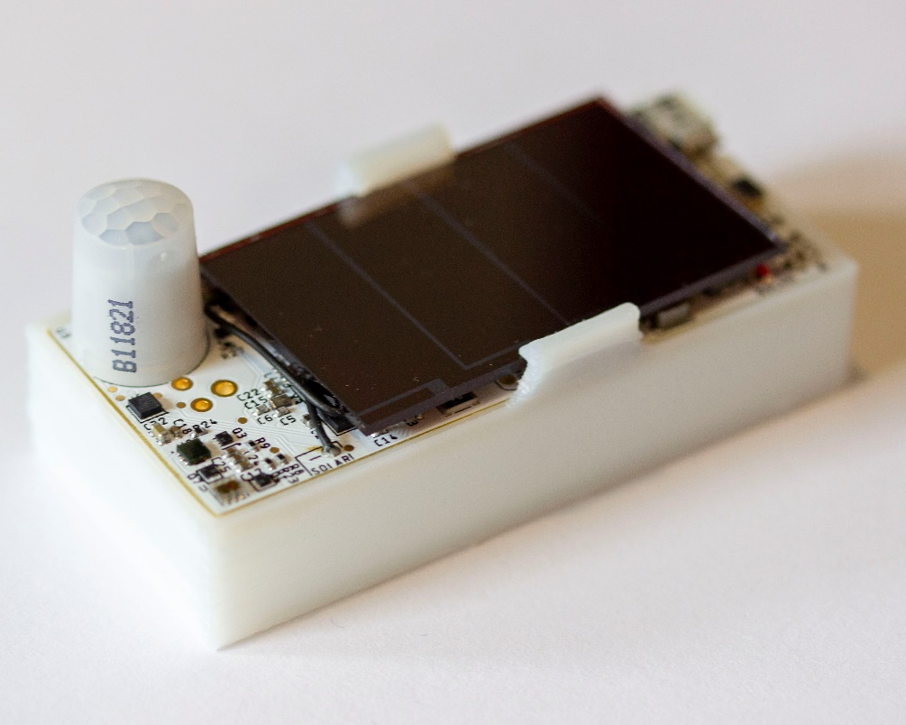
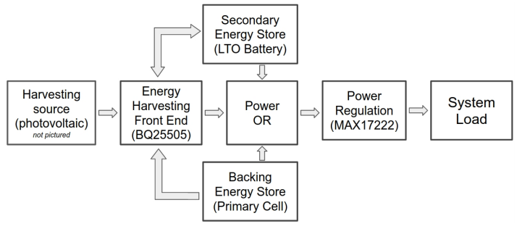
Permamote (Jackson, Adkins, Dutta)
Goal: create a 10-year wireless sensor
Solutions
Modern sensors and microcontroller
Energy harvesting combined with rechargeable battery
Non-rechargeable battery as backup power
https://lab11.eecs.berkeley.edu/content/pubs/jackson19capacity.pdf

Slide 30
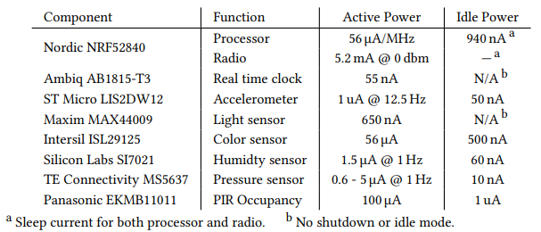
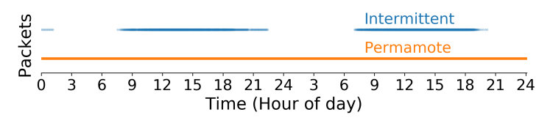
Permamote low energy design
Uses components with extremely low idle power to limit energy needs
Combination of harvesting plus battery enables continuous operation

Slide 31
Tock (Levy, Campbell, Ghena, Giffin, Pannuto, Dutta, Levis)
Goal: safe and reliable embedded OS
Demonstrate this is possible on small embedded platforms
Solutions
Dedicated OS kernel with separate applications
Protect applications with hardware features
Memory Protection Unit
Protect kernel with language features
Rust programming language
https://lab11.eecs.berkeley.edu/content/pubs/levy17multiprogramming.pdf

Slide 32

Tock software organization
C App Ported to Tock
App written in Rust
[Service] BLE Environmental Sensing Profile
while(1)
😈
Untrusted
(isolated by the MPU and preemptively scheduled)
Syscall Interface
libtock
libtock-rs
libtock
libnrf
Kernel (Rust)
System Calls
Thread
Virt. Timer
BLE
Temp. Sensor
Untrusted
(unsafe forbidden)
Capsules
6LoWPAN
SD Card
Console
SI7021
Core Kernel
Scheduler, Process management, etc.
Standardized Hardware Interface Layer (HIL)
Trusted
(unsafe allowed for MMIO, PIC, etc.)
Microcontroller-specific Peripheral Drivers
SPI
RNG
Timer
ADC
GPIO
I2C
UART
AES
DAC
USB
Hardware
CPU
SPI
RNG
Timer
ADC
GPIO
I2C
UART
AES
DAC
USB

Slide 33
Sensing systems research
Platforms
How to improve the capabilities of sensing systems
Examples: lower power, better wireless, new sensors
Applications
How to use sensing systems to meet some desired goal
Examples: track human interactions, measure household energy use

Slide 34
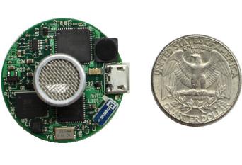
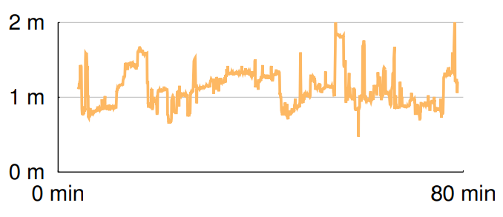
Opo (Huang, Kuo, Pannuto, Dutta)
Goal: sense distance of human interactions
Real-time, high accuracy, deployable
Solutions
Ultrasonic allows for low-power detection of nearby devices
Also provides directionality
Measure difference in arrival time of RF and Ultrasonic to determine distance
https://lab11.eecs.berkeley.edu/content/pubs/huang14opo.pdf

Slide 35
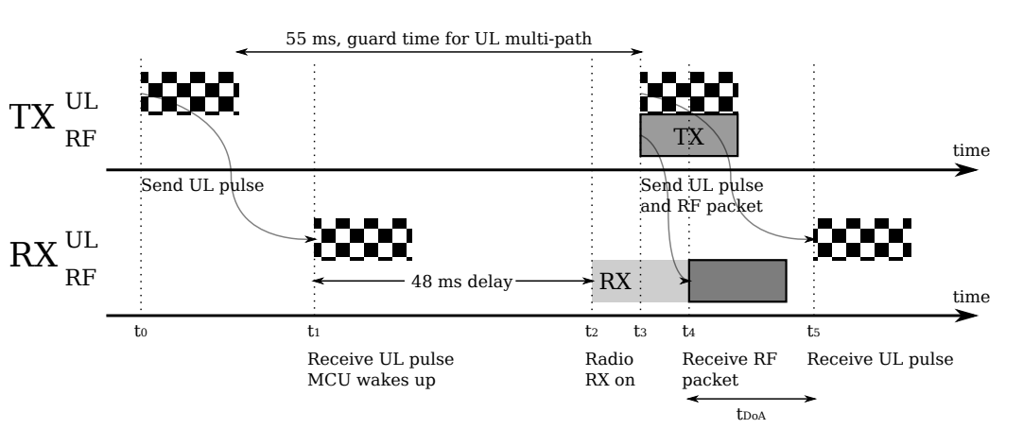
Opo low-energy ranging
RX of ultrasonic pulse wakes the device
Listens for RF and ultrasonic to measure time difference

Slide 36
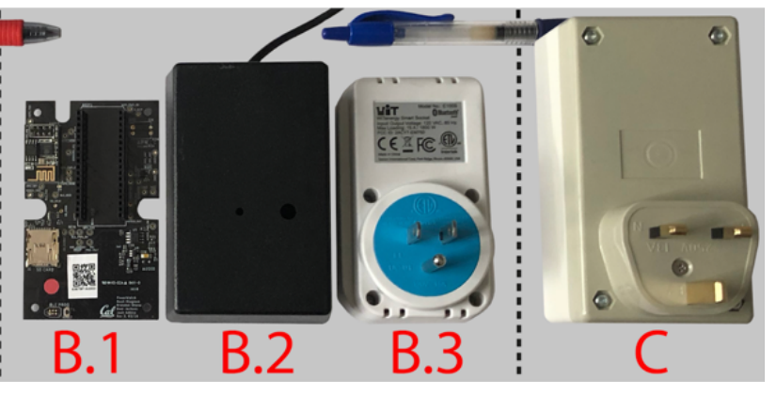
Powerwatch (Klugman, Adkins, et al.)
Goal: measure electric grid reliability in developing regions
“Access alone is insufficient. Reliability matters too.”
Solutions:
Wall-powered sensor with battery-backup to detect outages and report over cellular
Infrastructure to collect measurements and cross-correlate
Create a team to manage the deployment
https://lab11.eecs.berkeley.edu/content/pubs/klugman19scale.pdf

Slide 37
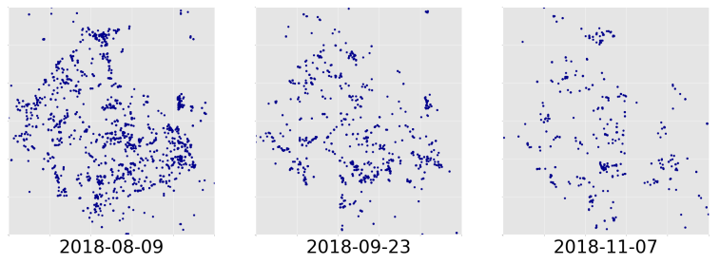
Powerwatch deployments require continuous upkeep
Handing someone a sensor does not guarantee long deployment
Initially 1000 devices fell to 600, then 300 over three months

Slide 38
Outline
What does research look like:
Research Overview
Example: Powerblade
Sensing Systems Research
Various Projects
Signpost

Slide 39
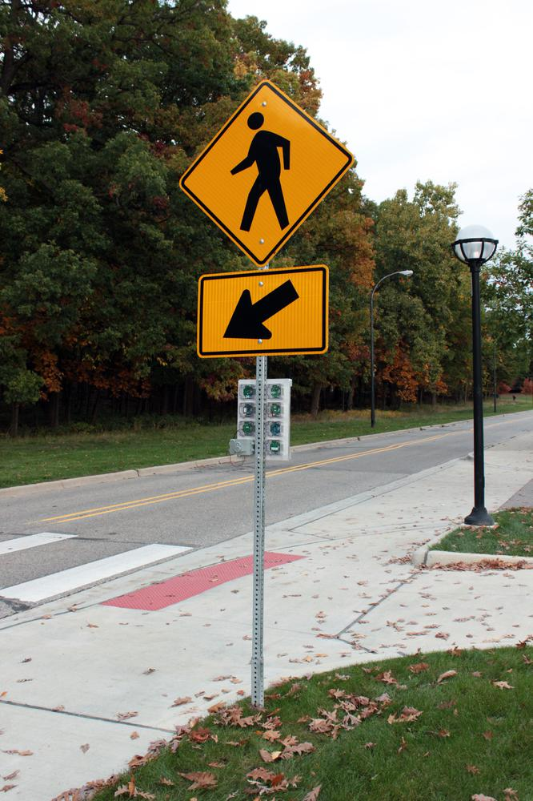
The Signpost Project
An example of “Platforms” research
Goal: platform that enables low-effort city-scale sensing deployments

Slide 40
What things might we want to sense at the scale of a city?

Slide 41
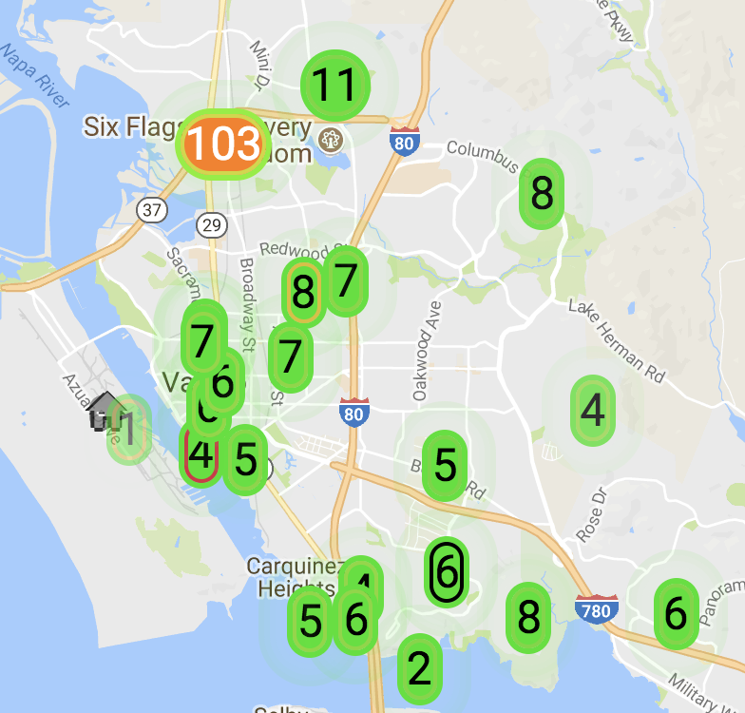
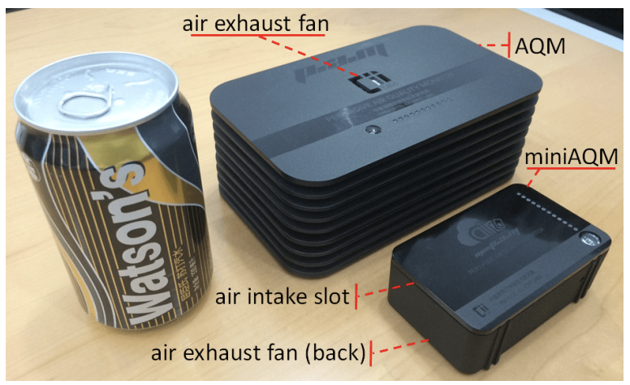
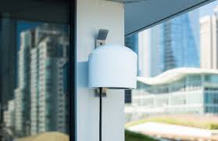
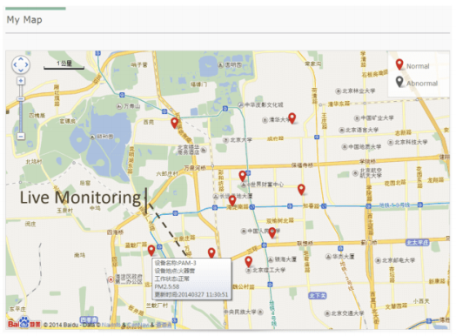
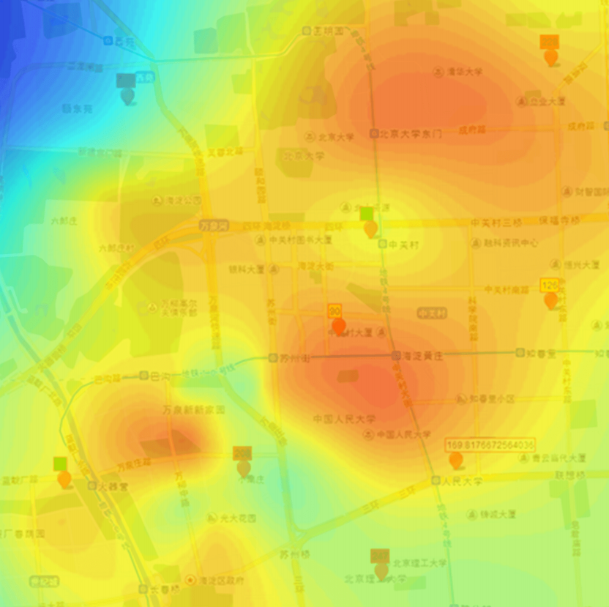
Air quality monitoring
[2]
[2]
[1]
[1]
[1] Cheng et al. AirCloud: a cloud-based air-quality monitoring system for everyone. 2014. [2] Purple Air. 2018.

Slide 42
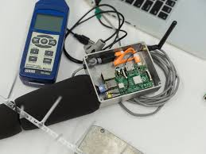
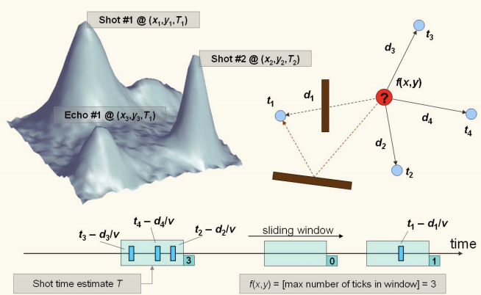
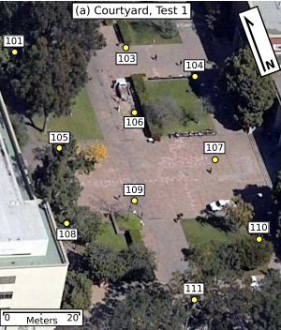
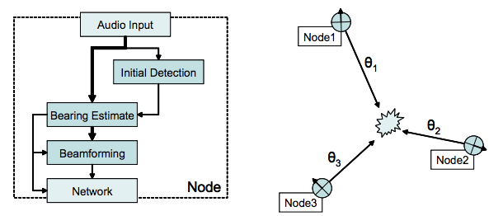
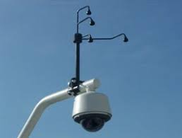
Audio detection, classification, and localization
[3]
[2]
[1]
[1]
[1] Girod et al. The Design and Implementation of a Self-Calibrating Distributed Acoustic Sensing Platform. 2006. [2] Lédeczi et al. Multiple Simultaneous Acoustic Source Localization in Urban Terrain. 2005. [3] Sounds of New York City. 2016.

Slide 43
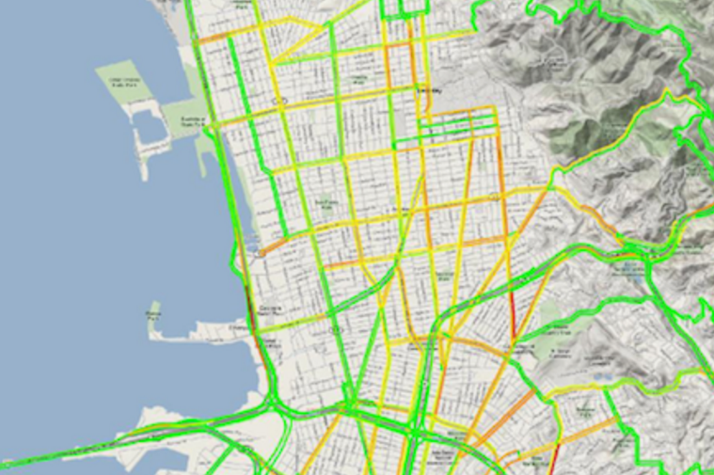
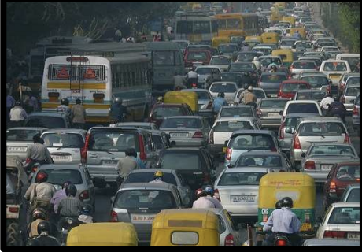
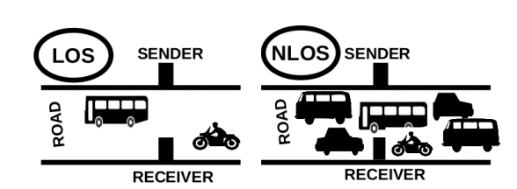
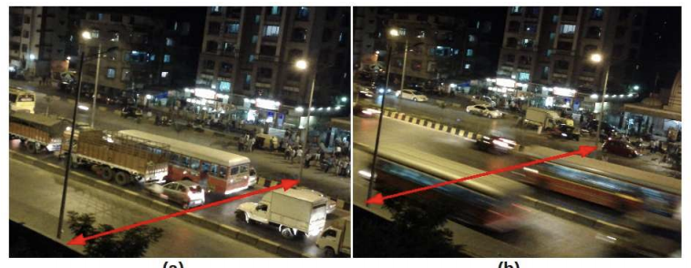
Traffic queue sensing and congestion control
[1]
[1]
[1]
[1] Sen et al. Kyun Queue: A Sensor Network System To Monitor Road Traffic Queues, 2012

Slide 44
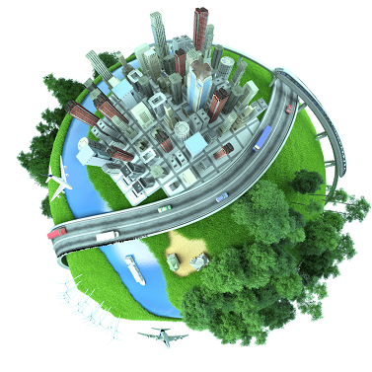








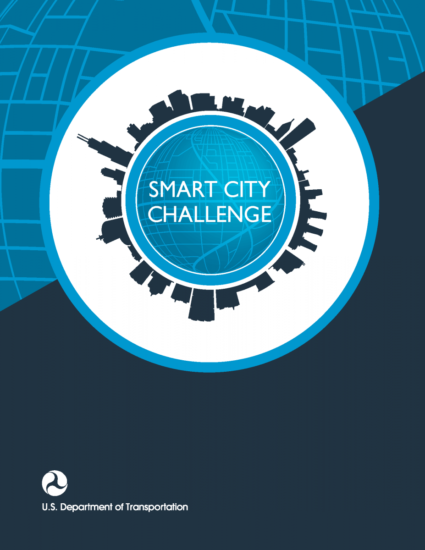



Slide 45
City-Scale Sensing Introduction
Signpost
Motivation
Shared Resources
Deployability
Implementation
Evaluation

Slide 46
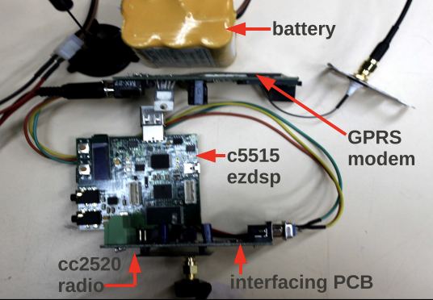
Air Quality Monitoring
Urban Noise Classification
Traffic Queue Sensing
[1]
[2]
[3]
Lots of interesting applications and interested parties. But let’s look at the process of actually creating and deploying an application.
[1] Cheng et al. AirCloud: a cloud-based air-quality monitoring system for everyone. 2014. [2] Sounds of New Your City. 2016. [3] Sen et al. Kyun Queue: A Sensor Network System To Monitor Road Traffic Queues, 2012

Slide 47
Many steps to building traffic queue sensing
Sensing Hypothesis/Hardware
[1] Sen et al. Kyun Queue: A Sensor Network System To Monitor Road Traffic Queues, 2012

Slide 48
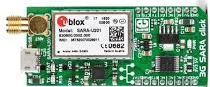
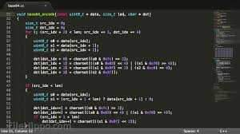
Many steps to building traffic queue sensing
Sensing Hypothesis/Hardware
Networking
Networking Driver
[1] Sen et al. Kyun Queue: A Sensor Network System To Monitor Road Traffic Queues, 2012

Slide 49
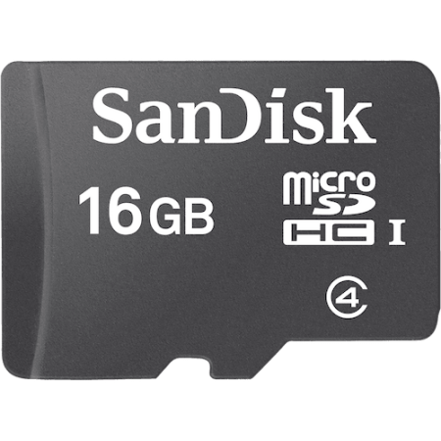
Many steps to building traffic queue sensing
Sensing Hypothesis/Hardware
Networking
Networking Driver
Storage
Storage Driver
[1] Sen et al. Kyun Queue: A Sensor Network System To Monitor Road Traffic Queues, 2012

Slide 50
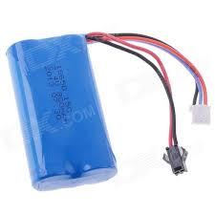
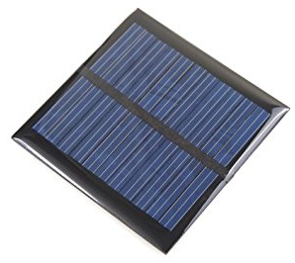

Many steps to building traffic queue sensing
Sensing Hypothesis/Hardware
Networking
Networking Driver
Storage
Storage Driver
Sustainable Power
[1] Sen et al. Kyun Queue: A Sensor Network System To Monitor Road Traffic Queues, 2012

Slide 51

Many steps to building traffic queue sensing
Sensing Hypothesis/Hardware
Networking
Networking Driver
Storage
Storage Driver
Sustainable Power
Weatherproof Casing
[1] Sen et al. Kyun Queue: A Sensor Network System To Monitor Road Traffic Queues, 2012

Slide 52

Many steps to building traffic queue sensing
Sensing Hypothesis/Hardware
Networking
Networking Driver
[1]
Storage
Storage Driver
Sustainable Power
Weatherproof Casing
Deploy
[1] Sen et al. Kyun Queue: A Sensor Network System To Monitor Road Traffic Queues, 2012

Slide 53

Key functions are repeated
[1]
Sensing Hypothesis/Hardware
Networking
Networking Driver
[1]
Storage
Storage Driver
Sustainable Power
Weatherproof Casing
Deploy
[1] Sounds of New York City. 2016

Slide 54
Key functions are repeated
[1]
Sensing Hypothesis/Hardware
Networking
Networking Driver
[1]
Storage
Storage Driver
Sustainable Power
Weatherproof Casing
Deploy
[1] Purple Air. 2018

Slide 55
Signpost Enables City-Scale Sensing
[1]
[1]
Sensing Hypothesis/Hardware
Deploy
Integrate with Signpost
Joshua Adkins, Branden Ghena, Neal Jackson, Pat Pannuto, Samuel Rohrer, Bradford Campbell, and Prabal Dutta ”The Signpost Platform for City-Scale Sensing." IPSN’18 - https://brandenghena.com/projects/signpost/adkins18signpost.pdf
[1] Purple Air. 2018.

Slide 56
City-Scale Sensing Introduction
Signpost
Motivation
Shared Resources
Deployability
Implementation
Evaluation

Slide 57
Key functions are repeated
[1]
Sensing Hypothesis/Hardware
Networking
Networking Driver
[1]
Storage
Storage Driver
Sustainable Power
Weatherproof Casing
Deploy
[1] Purple Air. 2018

Slide 58
Higher power/linux class processing
Can be provided with a GPS
Deployment | Services Needed
 | Power | Networking | Processing | Storage | Time | Synch | Location
Caraoke [3]
Bouillet et al. [4]
Aircloud [5]
Girod et al. [6]
Ledeczi et al. [7]
SenseFlow [8]
Argos [9]
SONYC [1]
Kyun Queue [10]
Micronet [11]

Slide 59



Software abstraction through a single interface
Sensor
Platform
Networking
Storage
Platform Interface
Platform Controller
High Performance Processing
Sensing Hypothesis/Hardware
- Ubiquitous
- Easy to adapt/implement
- Physically pluggable
Sustainable Power
GPS

Slide 60
City-Scale Sensing Introduction
Signpost
Motivation
Shared Resources
Deployability
Implementation
Evaluation

Slide 61
Some applications require granularity
Data can change greatly in low distances
Outlier
Notes:
If we want to

Slide 62

Deployment overhead drives cost
Expensive to work with the city
Time consuming
Not conducive to experimentation!
Do not rely on wired infrastructure
No wired power
Solar provides more power density than batteries
No wired networking
Should not modify existing infrastructure

Slide 63

Multi-tenancy is beneficial to testbeds
One deployment can enable many stakeholders simultaneously
Need to ensure that they do not conflict

Slide 64
City-Scale Sensing Introduction
Signpost
Motivation
Shared Resources
Deployability
Implementation
Evaluation

Slide 65

The Signpost Platform

Slide 66



Core modules provide shared resources
Control Module
Radio Module
GPS
Storage
3G
Networking
BLE
Processing
LoRa
Making the platform modular supports upgradeability

Slide 67

Measurement and isolation support multi-tenancy
Isolation
& Monitoring
Power Metering

Slide 68


Standard interface for accessing shared resources
Any software framework can be used for modules

Slide 69


Array of Things is one platform approach
Include sensors as platform resources
Applications are software that act on sensor data
High-power hardware and expensive to deploy

Slide 70
Signpost explores the other end of the spectrum
What can we do with less?
Low-power, low-capability, extremely deployable
Limited provided resources, but lots of extensibility
Focus on modularity
Too difficult to start from scratch for every upgrade/change
Components are more expensive
Deployments is more difficult
The platform should be viewed as shared infrastructure!
Amortize cost with multiple sensors and applications

Slide 71
City-Scale Sensing Introduction
Signpost
Motivation
Shared Resources
Deployability
Implementation
Evaluation

Slide 72


How much power does a Signpost harvest?
Higher daily variations than directional variations
Notes:
Bigger text ,fix font
Write takeaways on the slide

Slide 73

How much power can each module draw?
Notes:
Make sure to say it only gets better with scaling - better look
takeaway

Slide 74
How much power can each module draw?
Seattle 95th Percentile = 3 mW
San Diego 95th Percentile = 162 mW
Notes:
Make sure to say it only gets better with scaling - better look
takeaway

Slide 75

How much power can each module draw?
Notes:
Make sure to say it only gets better with scaling - better look
takeaway

Slide 76

Resources are charged to modules which use them
Notes:
Fix font

Slide 77


Applications running on Signpost
Environmental monitoring (posting to Weather Underground)
Vehicle counting (and bell tower)
TV whitespace sensing
Notes:
Fix font, callout on diurnal power patter/concert

Slide 78
Outline
What does research look like:
Research Overview
Example: Powerblade
Sensing Systems Research
Various Projects
Signpost

